Slide 1
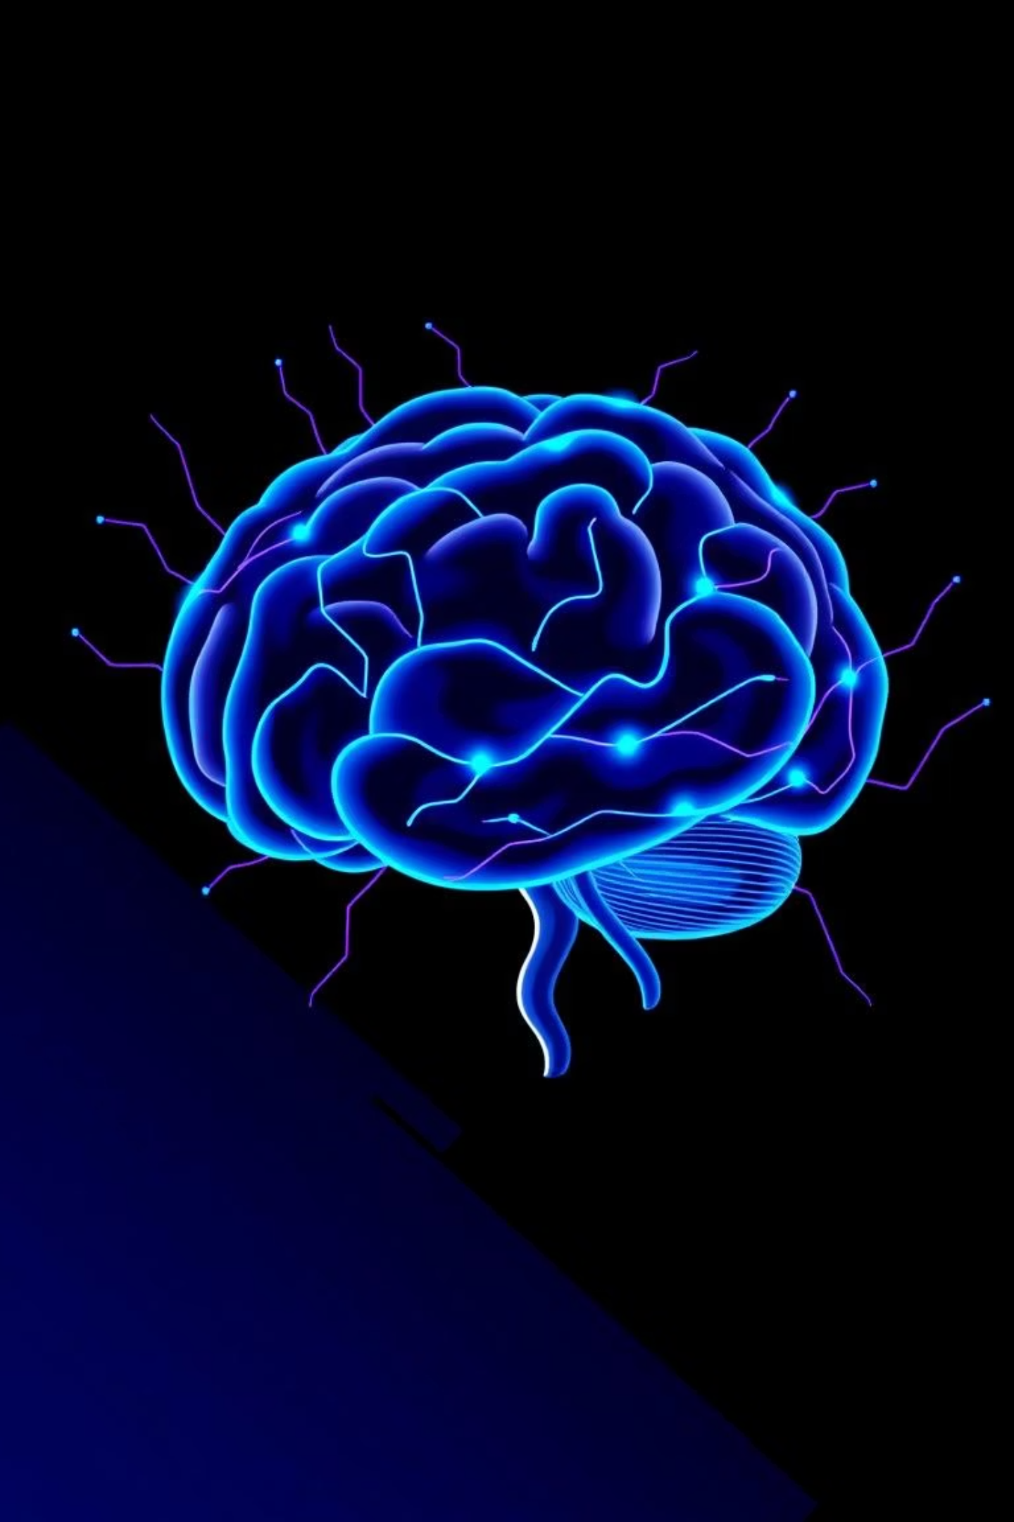
Machine Learning and Artificial Intelligence
Concepts, Algorithms, and Applications

Slide 2
Introduction to ML and AI
AI emulates human cognitive abilities, while ML enables computers to learn from data without explicit programming. This data-driven approach offers dynamic adaptability, fueling widespread adoption across industries.
1950
1
Alan Turing introduces the Turing Test.
2
1956
Dartmouth Conference formalizes AI.
1986
3
Backpropagation revolutionizes neural networks.
4
2012
AlexNet accelerates deep learning.
2018
5
BERT transforms NLP with transformers.
6
2020s
GPT-4 redefines AI capabilities.

Slide 3




Key Advantages of ML & AI
Scalability
Adaptability
Automation
Efficiently handles massive datasets using distributed computing.
Continuously refines performance with new data for lifelong learning.
Reduces human effort in data-intensive tasks, enhancing productivity.
Challenges
Data Dependency: Requires high-quality, unbiased datasets.
Computational Demand: Training advanced models needs significant resources.
Ethical Risks: Includes algorithmic bias, privacy, and job displacement.

Slide 4
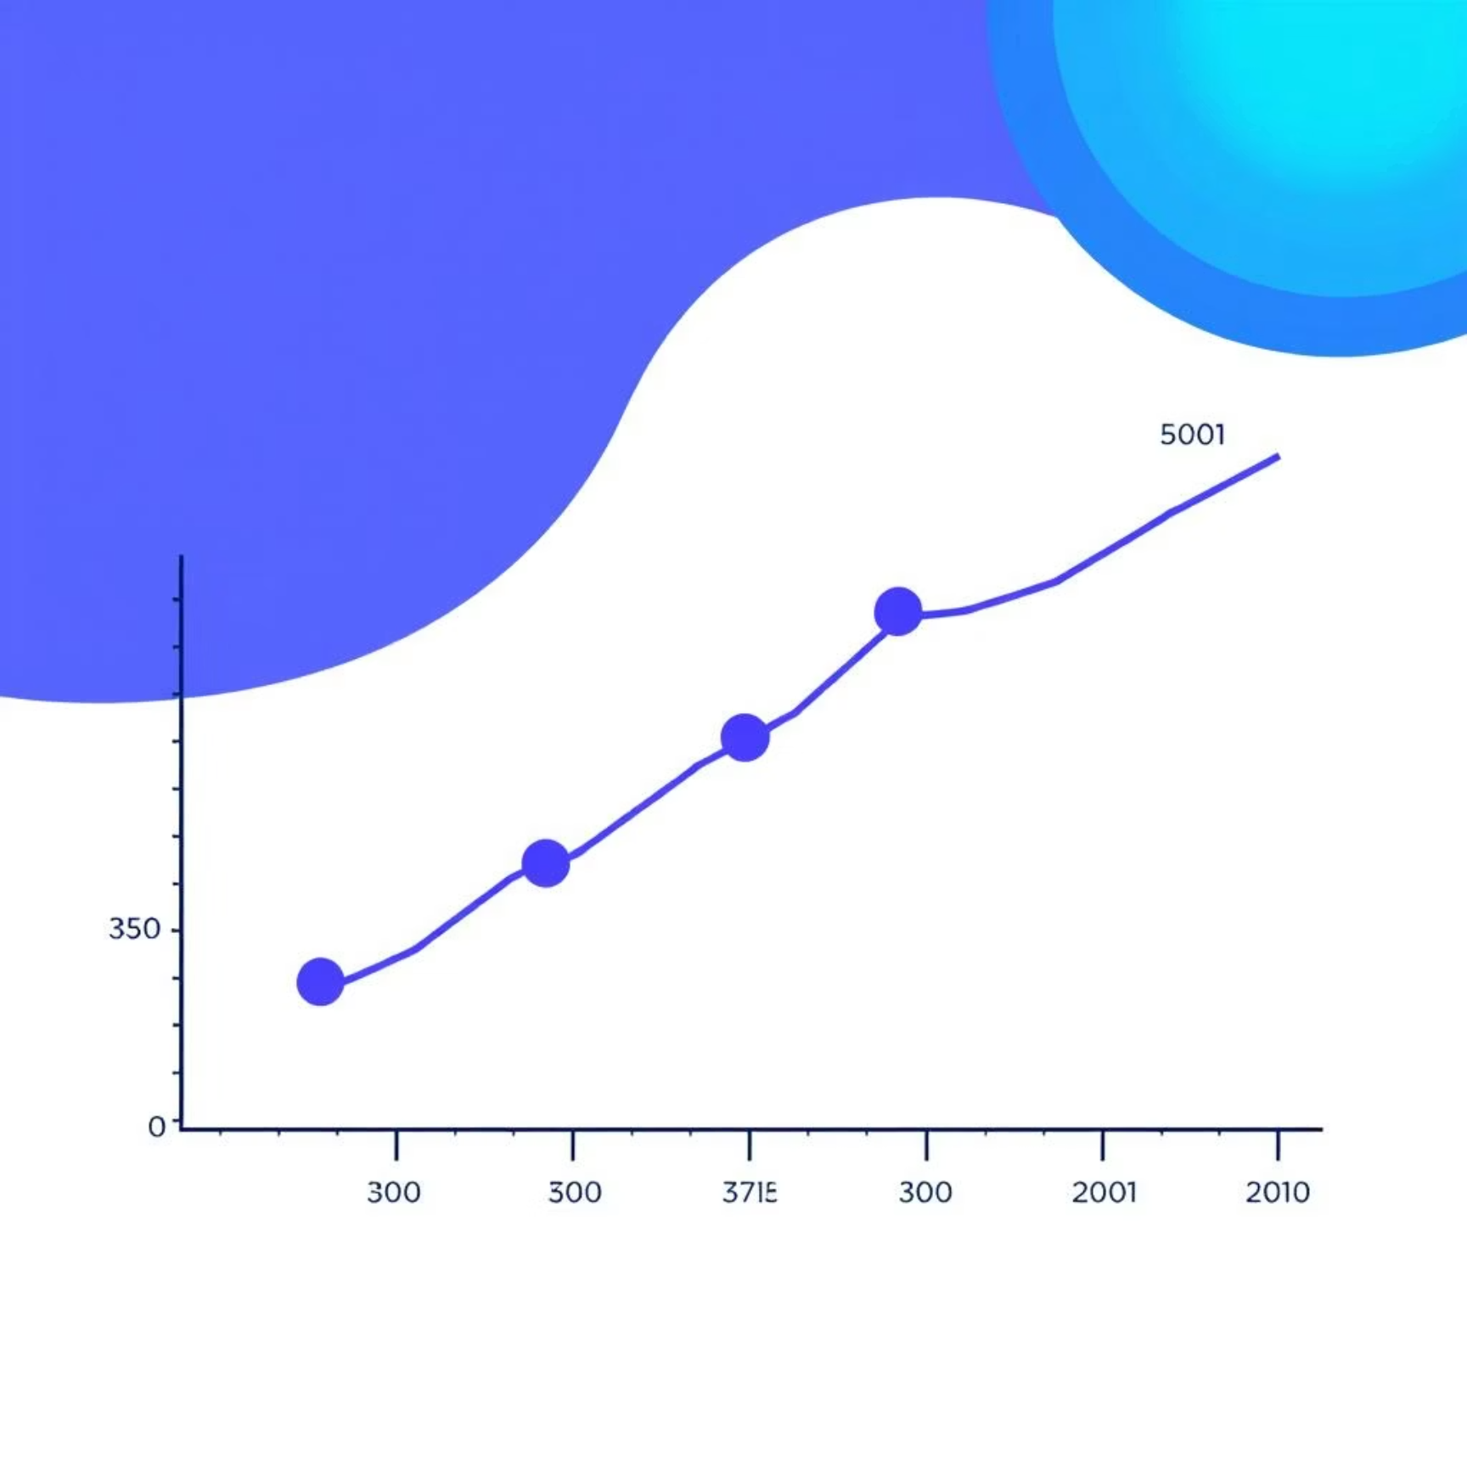
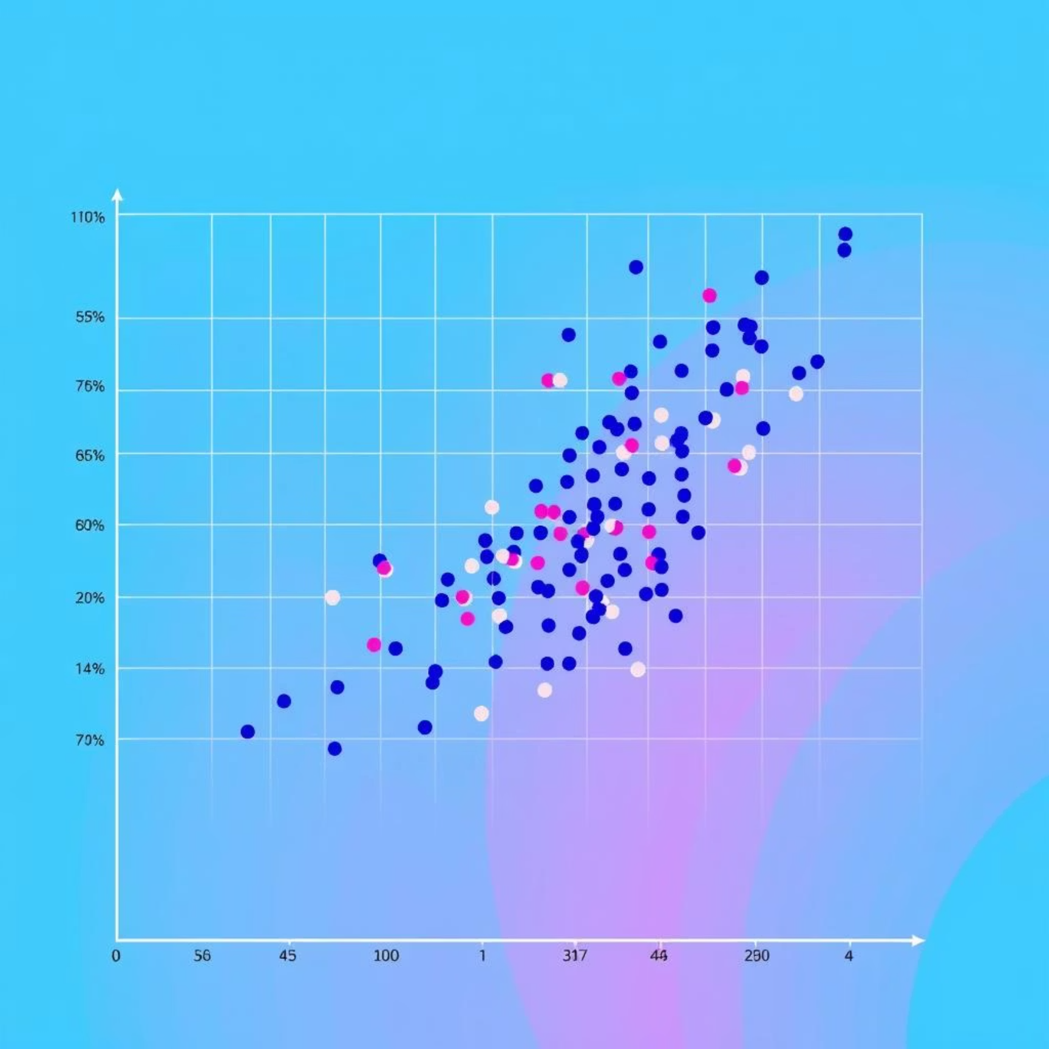
Types of Machine Learning
Supervised Learning
Unsupervised Learning
Uses labeled data to learn mapping functions for regression (e.g., house prices) and classification (e.g., spam detection).
Explores unlabeled data to uncover hidden structures, like clustering customers or reducing data dimensionality.

Slide 5








Reinforcement Learning
An agent learns optimal actions through trial and error in an environment to maximize rewards.
Agent
Environment
Performs actions in the environment.
Provides feedback and new states.
Policy
Reward
Agent's strategy for choosing actions.
Guides the agent towards optimal behavior.
Examples: Training robotic arms, AI for strategic games like Go, and autonomous vehicle navigation.

Slide 6
Data and Features in ML
Data quality and structure are crucial for model performance. Datasets are split into three subsets for robust evaluation.
Training Set (70%)
Validation Set (20%)
Test Set (10%)
Teaches the model patterns and relationships.
Tunes hyperparameters and prevents overfitting.
Assesses generalization to unseen data.
Feature Engineering
Selecting, transforming, or creating features (e.g., square footage for house prices) to enhance predictive power.

Slide 7
Data Preprocessing Steps
Cleaning
1
Addresses missing values and removes outliers.
Normalization
2
Scales features to a uniform range (e.g., 0 to 1).
Encoding
3
Transforms categorical variables into numerical formats.
Feature Selection
4
Identifies the most relevant features, reducing dimensionality.
Transformation
5
Applies mathematical operations to capture non-linear relationships.

Slide 8

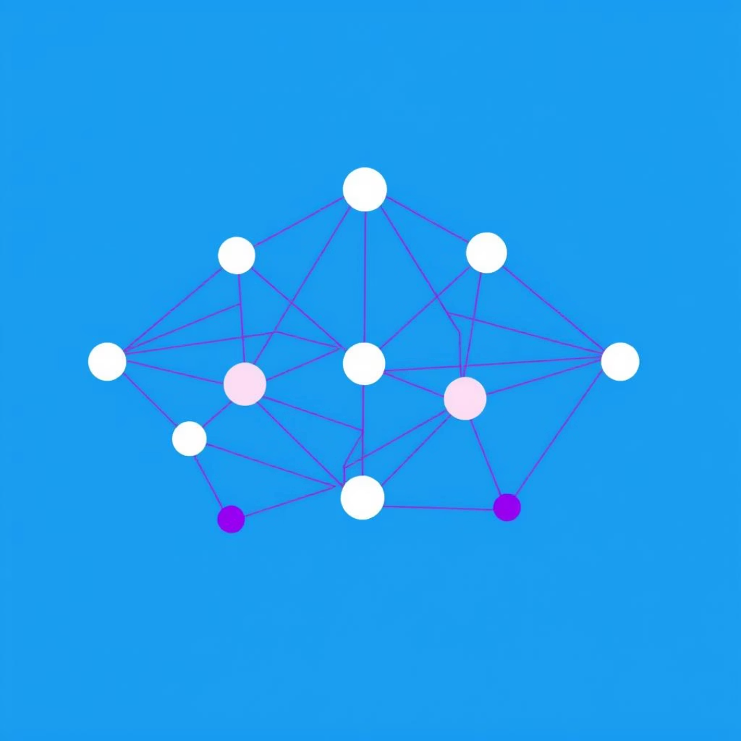

Neural Networks and Deep Learning
Inspired by the human brain, these models capture complex, hierarchical patterns in data.
CNNs
RNNs
Transformers
Detect local patterns in images/videos (e.g., ResNet for ImageNet accuracy).
Process sequential data with memory (e.g., LSTMs for speech recognition).
Use attention mechanisms for parallel sequence processing (e.g., BERT, GPT for NLP).

Slide 9






Applications of AI and ML
Healthcare
Finance
Disease detection, predictive analytics, personalized medicine.
Fraud detection, algorithmic trading, risk management.
NLP
Autonomous Systems
Chatbots, translation, sentiment analysis.
Self-driving cars, drones, robotics.
Retail & E-Commerce
Environmental Science
Recommendation systems, inventory management, customer service.
Climate modeling, wildlife conservation.

Slide 10
Future Directions & Challenges
Future Trends
Advanced Topics
AI Ethics: Bias, transparency, accountability.
Explainable AI (XAI): Interpreting model decisions.
Human-AI Collaboration: Augmenting human decision-making.
Edge AI: Deploying models on devices.
Quantum ML: Exploring quantum algorithms.
Sustainability: AI optimizing energy use.
As of June 30, 2025, AI adoption is accelerating, with India leading in healthcare AI innovations and global efforts focusing on sustainable AI solutions.

